Slide 1

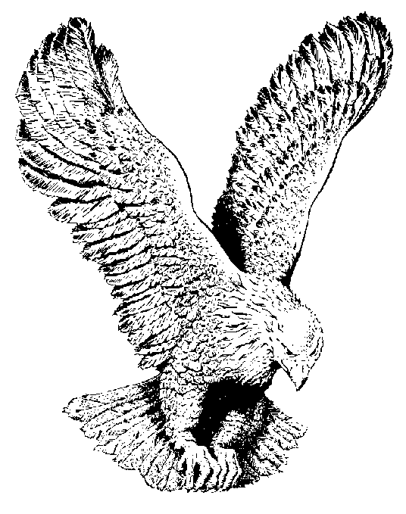
823 HE’S STILL WORKING ON ME
There really ought to be a sign upon my heart
Don't judge me yet, there's an unfinished work;
But I'll be perfect just according to His plan,
Fashioned by the Master's loving hand.

Slide 2
CHORUS
He's still working on me,
To make me what I ought to be.
It took Him just a week to make the moon and the stars,
The Sun and the Earth, Jupiter and Mars.
How loving and patient He must be,
He's still working on me.

Slide 3
In the mirror of His word,
Reflection that I see, makes me wonder why He never gave up on me.
He loves me as I am and hears me when I pray;
Remember He's the Potter I'm the clay.

